Slide 1


SAP UI5 FIORI
JQuery
www.zarantech.com
© Copyright 2021, ZaranTech LLC. All rights reserved.

Slide 2

Disclaimer
2
This presentation, including examples, images, and references are provided for informational purposes only.
Complying with all applicable copyrights laws is the responsibility of the user.
Without limiting the rights under copyright, no part of this document may be reproduced, stored or introduced into a retrieval system, or transmitted in any form or by any means.
Credits shall be given to the images taken from the open-source and cannot be used for promotional activities.
© Copyright 2021, ZaranTech LLC. All rights reserved.

Slide 3
Agenda
3
JQuery Overview
Why JQuery
jQuery CDN
jQuery Syntax
jQuery Selectors
Events
DOM Manipulation
© Copyright 2021, ZaranTech LLC. All rights reserved.

Slide 4

Before JQuery
2
Before you start studying jQuery, you should have a basic knowledge of:
HTML
CSS
JavaScript
‹#›
© Copyright 2021, ZaranTech LLC. All rights reserved.

Slide 5
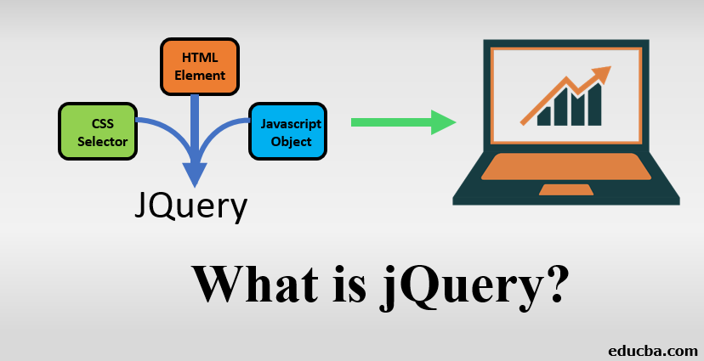
What is JQuery?
2
‹#›
© Copyright 2021, ZaranTech LLC. All rights reserved.

Slide 6
What is JQuery?
2
jQuery is a lightweight, "write less, do more", JavaScript library.
The purpose of jQuery is to make it much easier to use JavaScript on your website.
jQuery takes a lot of common tasks that require many lines of JavaScript code to accomplish, and wraps them into methods that you can call with a single line of code.
‹#›
© Copyright 2021, ZaranTech LLC. All rights reserved.

Slide 7
What is JQuery?
2
jQuery Library
HTML/DOM manipulation
CSS manipulation
HTML event methods
Effects and animations
AJAX
Utilities
‹#›
© Copyright 2021, ZaranTech LLC. All rights reserved.

Slide 8
Why JQuery?
2
There are lots of other JavaScript libraries out there, but jQuery is probably the most popular, and also the most extendable.
Many of the biggest companies on the Web use jQuery, such as:
Google
Microsoft
IBM
Netflix
‹#›
© Copyright 2021, ZaranTech LLC. All rights reserved.

Slide 9
Will JQuery works in all Browsers?
2
jQuery team knows all about cross-browser issues, and they have written this knowledge into the jQuery library.
jQuery will run exactly the same in all major browsers.
‹#›
© Copyright 2021, ZaranTech LLC. All rights reserved.

Slide 10
Adding JQuery to Webpages
2
Download the jQuery library from jQuery.com
Include jQuery from a CDN, like Google
‹#›
© Copyright 2021, ZaranTech LLC. All rights reserved.

Slide 11
JQuery Syntax
2
The jQuery syntax is tailor-made for selecting HTML elements and performing some action on the element(s).
Basic syntax is: $(selector).action()
A $ sign to define/access jQuery
A (selector) to "query (or find)" HTML elements
A jQuery action() to be performed on the element(s)
‹#›
© Copyright 2021, ZaranTech LLC. All rights reserved.

Slide 12
JQuery Syntax - Examples
2
$(this).hide() - hides the current element.
$("p").hide() - hides all <p> elements.
$(".test").hide() - hides all elements with class="test".
$("#test").hide() - hides the element with id="test".
‹#›
© Copyright 2021, ZaranTech LLC. All rights reserved.

Slide 13
JQuery - Events
2
An event represents the precise moment when something happens. For example:
Moving a mouse over an element
Selecting a radio button
Clicking on an element
‹#›
© Copyright 2021, ZaranTech LLC. All rights reserved.

Slide 14
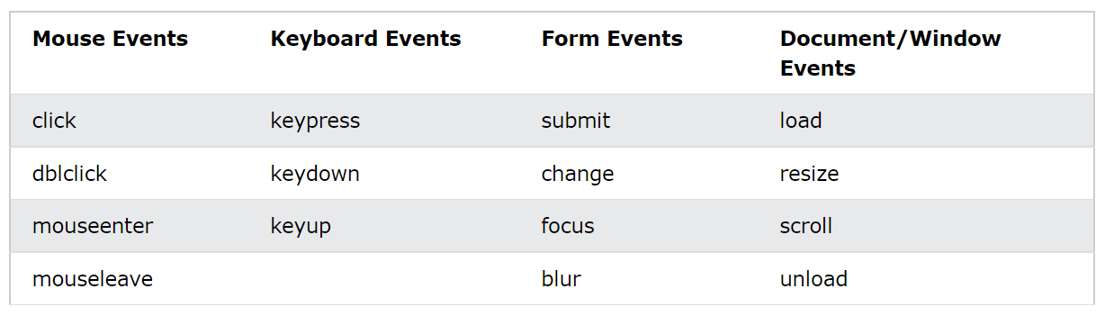
JQuery – Common DOM Events
2
‹#›
© Copyright 2021, ZaranTech LLC. All rights reserved.

Slide 15
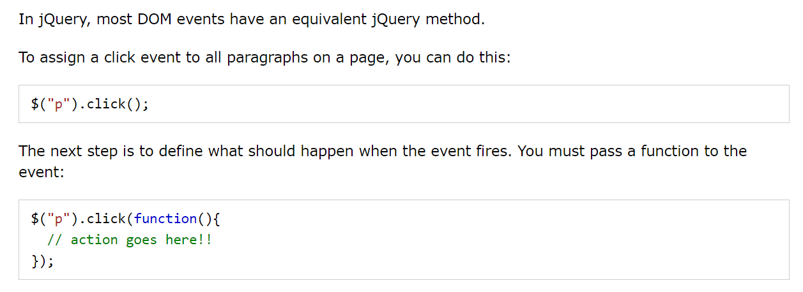
JQuery – Syntax for Event Methods
2
‹#›
© Copyright 2021, ZaranTech LLC. All rights reserved.

Slide 16
JQuery – Commonly Used JQuery Event Methods
2
$(document).ready()
click() & dblclick()
mouseenter()
mouseleave()
mousedown()
mouseup()
hover()
Focus()
Blur()
On()
‹#›
© Copyright 2021, ZaranTech LLC. All rights reserved.

Slide 17
Thank you
Subscribe to our Channel for more Informative Videos.
https://www.youtube.com/user/ZaranTech

